Slide 1
Session 13 : Date, Time, Tabs and Sliding Drawers Widgets
Module 4.3 : Android

Slide 2
Learning Objectives
At the end of the session successful participants will be able to
Create following:
Date component
Time component
Tabs
Sliding Drawers

Slide 3
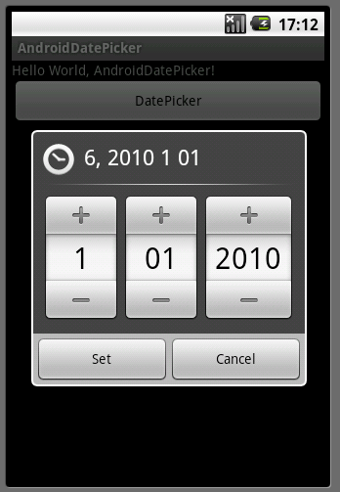
Date, Time, Tabs And Sliding Drawer Widgets
Date

Slide 4
Date, Time, Tabs And Sliding Drawer Widgets
Date
Android also supports widgets (DatePicker, TimePicker) and dialogs (DatePickerDialog, TimePickerDialog) for helping users enter dates and times.
The DatePicker and DatePickerDialog allow you to set the starting date for the selection, in the form of a year, month, and day.

Slide 5
Date, Time, Tabs And Sliding Drawer Widgets
Date
Value of month runs from 0 for January through 11 for December
Each widget provides a callback object (OnDateChangedListener or OnDateSetListener) where you are informed of a new date selected by the user.

Slide 6
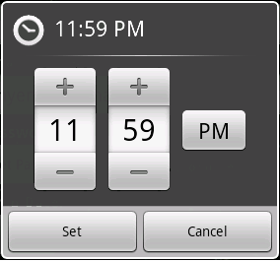
Date, Time, Tabs And Sliding Drawer Widgets
Time

Slide 7
Date, Time, Tabs And Sliding Drawer Widgets
Time
The widgets TimePicker and TimePickerDialog let you:
set the initial time the user can adjust, in the form of an hour (0 through 23) and a minute (0 through 59)
indicate if the selection should be in 12‐hour mode (with an AM/PM toggle), or in 24‐hour mode.
Provide a callback object (OnTimeChangedListener or OnTimeSetListener) to be notified of when the user has chosen a new time (which is supplied to you in the form of an hour and minute)

Slide 8
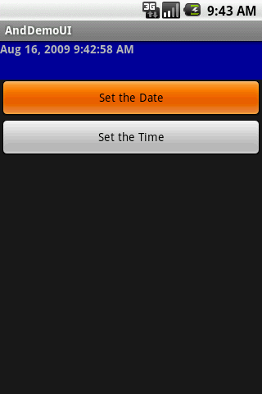
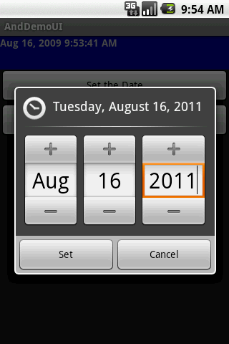
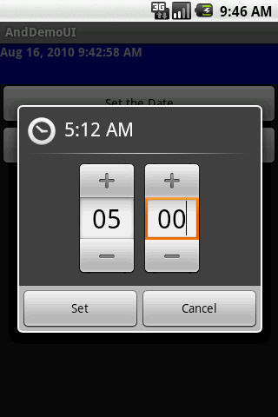
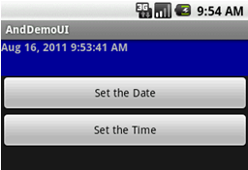
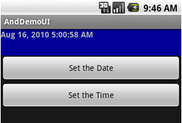
Date, Time, Tabs And Sliding Drawer Widgets
Date & Time: Example Using Calendar Widgets

Slide 9
Date, Time, Tabs And Sliding Drawer Widgets
Date & Time: Example Using Calendar Widgets
<?xml version="1.0" encoding="utf-8"?>
<LinearLayout
android:id="@+id/widget28"
android:layout_width="fill_parent"
android:layout_height="fill_parent"
android:orientation="vertical"
xmlns:android="http://schemas.android.com/apk/res/android”>
<TextView
android:id="@+id/lblDateAndTime"
android:layout_width="fill_parent"
android:layout_height="47px"
android:background="#ff000099"
android:textStyle="bold”>

Slide 10
Date, Time, Tabs And Sliding Drawer Widgets
Date & Time: Example Using Calendar Widgets
</TextView>
<Button
android:id="@+id/btnDate"
android:layout width="fill parent“
layout_width fill_parent
android:layout_height="wrap_content"
android:text="Set the Date”>
</Button>
<Button
android:id="@+id/btnTime"
android:layout_width="fill_parent"
android:layout_height="wrap_content"
android:text="Set the Time”>
</Button></LinearLayout>

Slide 11
Date, Time, Tabs And Sliding Drawer Widgets
Date & Time: Example Using Calendar Widgets
package cis493.demoui;
import android.app.Activity;
import android.os.Bundle;
import android.app.DatePickerDialog;
import android.app.TimePickerDialog;
import android.view.View;
import android.widget.Button;
import android.widget.DatePicker;
import android.widget.TimePicker;
import android.widget.TextView;
import java.text.DateFormat;
import java.util.Calendar;

Slide 12
Date, Time, Tabs And Sliding Drawer Widgets
Date & Time: Example Using Calendar Widgets
public class AndDemoUI extends Activity {
DateFormat fmtDateAndTime = DateFormat.getDateTimeInstance();
TextView lblDateAndTime;
Calendar myCalendar = Calendar.getInstance();
DatePickerDialog.OnDateSetListener = new DatePickerDialog.OnDateSetListener()
{
public void onDateSet(DatePicker view,
int year, int monthOfYear, int dayOfMonth) {

Slide 13
Date, Time, Tabs And Sliding Drawer Widgets
Date & Time: Example Using Calendar Widgets
myCalendar.set(Calendar.MONTH, monthOfYear);
myCalendar.set(Calendar.DAY_OF_MONTH, dayOfMonth);
updateLabel();
}
};

Slide 14
Date, Time, Tabs And Sliding Drawer Widgets
Date & Time: Example Using Calendar Widgets
TimePickerDialog.OnTimeSetListener t = new TimePickerDialog.OnTimeSetListener()
{
public void onTimeSet(TimePicker view, int hourOfDay, int minute) {
myCalendar.set(Calendar.HOUR_OF_DAY, hourOfDay);
myCalendar.set(Calendar.MINUTE, minute);
updateLabel();
}
};
private void updateLabel() {
lblDateAndTime.setText(fmtDateAndTime.format(myCalendar.getTime()));
}

Slide 15
Date, Time, Tabs And Sliding Drawer Widgets
Date & Time: Example Using Calendar Widgets
@Override
public void onCreate(Bundle icicle) {
super.onCreate(icicle);
setContentView(R.layout.main);
lblDateAndTime = (TextView) findViewById(R.id.lblDateAndTime);
Button btnDate = (Button) findViewById(R.id.btnDate);
btnDate.setOnClickListener(new View.OnClickListener() {
public void onClick(View v) {
new DatePickerDialog(AndDemoUI.this, d,
myCalendar.get(Calendar.YEAR),
myCalendar.get(Calendar.MONTH),
myCalendar.get(Calendar.DAY_OF_MONTH)).show();

Slide 16
Date, Time, Tabs And Sliding Drawer Widgets
Date & Time: Example Using Calendar Widgets
}
});
Button btnTime = (Button) findViewById(R.id.btnTime);
btnTime.setOnClickListener(new View.OnClickListener() {
publicvoidonClick(View v) {
newTimePickerDialog(AndDemoUI.this, t,
myCalendar.get(Calendar.HOUR_OF_DAY),
myCalendar.get(Calendar.MINUTE), true).show();
}
});
updateLabel();
}// onCreate
} //class

Slide 17
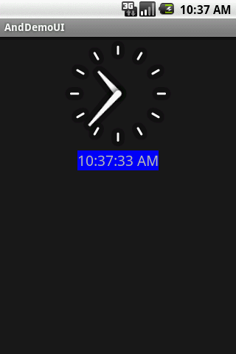
Date, Time, Tabs And Sliding Drawer Widgets
Other Time Widgets
Android provides a DigitalClock and AnalogClock widgets. Automatically update with the passage of time (no user intervention is required).
<?xml version="1.0" encoding="utf-8"?>
<RelativeLayout
android:id="@+id/widget34"
android:layout_width="fill_parent"
android:layout_height="fill_parent"
xmlns:android="http://schemas.android.com/apk/res/android"
>
<DigitalClock
android:id="@+id/digital"
android:layout_width="wrap_content”

Slide 18
Date, Time, Tabs And Sliding Drawer Widgets
Other Time Widgets
Android provides a DigitalClock and AnalogClock widgets. Automatically update with the passage of time (no user intervention is required).
android:background="#ff0000ff"
android:textSize="20px"
d id l t b l "@+id/ l "
9
android:layout_below="@+analog"
android:layout_centerHorizontal="true"
>
</DigitalClock>
<AnalogClock
android:id="@+id/analog”

Slide 19
Date, Time, Tabs And Sliding Drawer Widgets
Other Time Widgets
Android provides a DigitalClock and AnalogClock widgets. Automatically update with the passage of time (no user intervention is required).
android:layout_width="fill_parent"
android:layout_height="wrap_content"
android:layout_alignParentTop="true"
android:layout_alignParentLeft="true"
>
</AnalogClock>
</RelativeLayout>

Slide 20
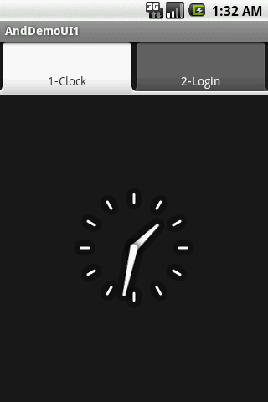
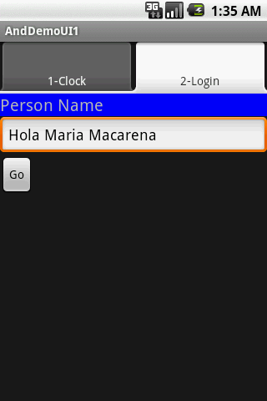
Date, Time, Tabs And Sliding Drawer Widgets
Tab
Android UIs should be kept simple at all costs
When many pieces of information must be displayed in a single app, the Tab Widget could be used to make the user aware of the pieces but show only a portion at the time.

Slide 21
Date, Time, Tabs And Sliding Drawer Widgets
Tab - Components
There are a few widgets and containers you need to use in order to set up a tabbed portion of a view:
TabHost is the main container for the tab buttons and tab contents
TabWidget implements the row of tab buttons, which contain text labels and optionally contain icons
FrameLayout is the container for the tab contents

Slide 22
Date, Time, Tabs And Sliding Drawer Widgets
Tab - Components
Tab 1
Tab 2
Tab 3
Tab Widgets
FrameLayout 1
TabHost
FrameLayouts

Slide 23
Date, Time, Tabs And Sliding Drawer Widgets
Tab: Example
<?xml version="1.0" encoding="utf-8"?>
<LinearLayout xmlns:android="http://schemas.android.com/apk/res/android"
android:orientation="vertical"
android:layout_width="fill_parent"
android:layout_height="fill_parent">
<TabHost android:id="@+id/tabhost"
android:layout_width="fill_parent"
android:layout_height="fill_parent">
<TabWidget android:id="@android:id/tabs"
android:layout_width="fill_parent"
android:layout_height="wrap_content"
/>

Slide 24
Date, Time, Tabs And Sliding Drawer Widgets
Tab: Example
<FrameLayout
android:id="@android:id/tabcontent"
android:layout width="fill parent"
layout_width= fill_parent
android:layout_height="fill_parent"
android:paddingTop="62px">
PUT HERE FrameLayout1
PUT HERE FrameLayout2
</FrameLayout>
</TabHost>
</LinearLayout>

Slide 25
Date, Time, Tabs And Sliding Drawer Widgets
Tab: Example
This is FrameLayout1. It defines an analog clock
<AnalogClock
android:id="@+id/tab1"
android:layout_width="fill_parent"
android:layout_height="fill_parent"
android:layout centerHorizontal="true"
/>

Slide 26
Date, Time, Tabs And Sliding Drawer Widgets
Tab: Example
This is FrameLayout2. It defines an LinearLayout holding a label, a textBox, and a button.
<LinearLayout
android:id="@+id/tab2"
android:layout_width="fill_parent"
android:layout_height="fill_parent"
android:orientation="vertical"
xmlns:android="http://schemas.android.com/apk/res/android"
>
<TextView
android:id="@+id/caption1"
android:layout_width="fill_parent"
android:layout_height="wrap_content"
android:background="#ff0000ff”

Slide 27
Date, Time, Tabs And Sliding Drawer Widgets
Tab: Example
This is FrameLayout2. It defines an LinearLayout holding a label, a textBox, and a button.
android:text="Person Name"
android:textSize="20px"
>
</TextView>
<EditText
android:id="@+id/txtPerson"
android:layout_width="fill_parent"
android:layout_height="wrap_content"
android:text="txtPerson"
android:textSize="18sp"
>
</EditText>

Slide 28
Date, Time, Tabs And Sliding Drawer Widgets
Tab: Example
This is FrameLayout2. It defines an LinearLayout holding a label, a textBox, and a button.
<Button
android:id="@+id/btnGo"
android:layout_width="wrap_content"
android:layout_height="wrap_content"
android:text="Go"
>
</Button>
</LinearLayout>

Slide 29
Date, Time, Tabs And Sliding Drawer Widgets
Tab: Example
@Override
public void onCreate(Bundle icicle) {
super.onCreate(icicle);
setContentView(R.layout.main);
TabHost tabs=(TabHost)findViewById(R.id.tabhost);
tabs.setup(); TabHost.TabSpec spec;
spec =tabs.newTabSpec("tag1");
spec.setContent(R.id.tab1);
spec.setIndicator("1-Clock");
tabs.addTab(spec);
spec=tabs.newTabSpec("tag2");
spec.setContent(R.id.tab2);
spec.setIndicator("2-Login");
tabs.addTab(spec); tabs.setCurrentTab(0);

Slide 30
Date, Time, Tabs And Sliding Drawer Widgets
Tab: Example
Button btnGo = (Button)findViewById(R.id.btnGo);
btnGo.setOnClickListener(new OnClickListener() {
@Override
public void onClick(View arg0) {
EditText txtPerson =
(EditText)findViewById(R.id.txtPerson);
String theUser = txtPerson.getText().toString();
txtPerson.setText("Hola " + theUser);
}
});
}
}

Slide 31
Date, Time, Tabs And Sliding Drawer Widgets
SlidingDrawer Widget
SlidingDrawer hides content out of the screen and allows the user to drag a handle to bring the content on screen.
SlidingDrawer can be used vertically or horizontally.
SlidingDrawer should be used as an overlay inside layouts. This means SlidingDrawer should only be used inside of a FrameLayout or a RelativeLayout for instance.
The size of the SlidingDrawer defines how much space the content will occupy once slid out so SlidingDrawer should usually use fill_parent for both its dimensions.

Slide 32
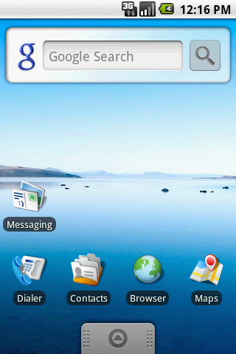
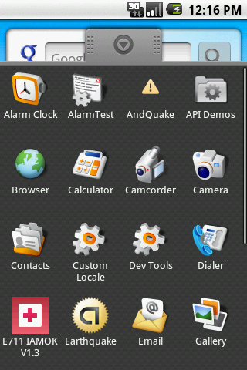
Date, Time, Tabs And Sliding Drawer Widgets
SlidingDrawer Widget: Example
This SlidingDrawer is used by the Android’s interface to access applications installed in the device.
handle
handle

Slide 33
Date, Time, Tabs And Sliding Drawer Widgets
SlidingDrawer Widget: Example
<SlidingDrawer
android:id="@+id/drawer"
android:layout_width="fill_parent"
android:layout_height="fill_parent"
android:handle="@+id/handle"
android:content="@+id/content">
<ImageView
android:id="@id/handle"
android:layout_width="88dip"
android:layout_height="44dip" />
<GridView android:id="@id/content"
android:layout_width="fill_parent"
android:layout_height="fill_parent" />
</SlidingDrawer>
handle is just a small graphic to visually indicate the opening/closing control
content is usually some type of container holding the desired UI held by the drawer

Slide 34
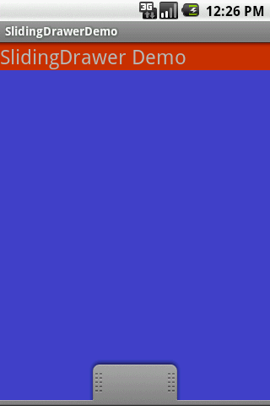
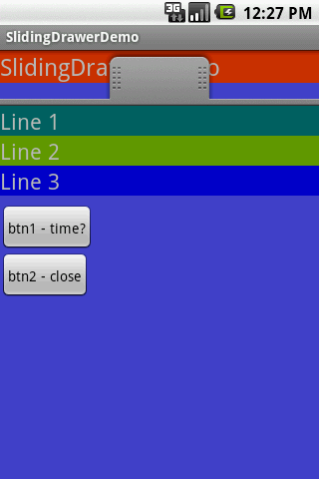
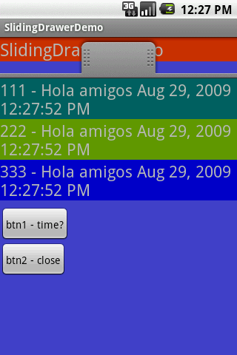
Date, Time, Tabs And Sliding Drawer Widgets
SlidingDrawer Widget: Example
A more elaborated SlidingDrawer
The red TextView simulates the main UI, the SlidingDrawer is an overlay, tapping the handle opens the new view
The background UI is overlapped by the contents of the drawer. Tapping the handle closes the drawer (but does not erase its data)

Slide 35
Date, Time, Tabs And Sliding Drawer Widgets
SlidingDrawer Widget: Example
SlidingDrawer XML layout (main UI)
<?xml version="1.0" encoding="utf-8"?>
<RelativeLayout
xmlns:android="http://schemas.android.com/apk/res/android"
android:layout_width="fill_parent"
android:layout_height="fill_parent"
android:background="#FF4444CC"
>
<TextView
android:id="@+id/label0"
android:layout_alignParentTop="true"
android:layout_width="fill_parent”

Slide 36
Date, Time, Tabs And Sliding Drawer Widgets
SlidingDrawer Widget: Example
SlidingDrawer XML layout (main UI)
android:layout_height="wrap_content"
android:background="#ffcc3300"
android:text="SlidingDrawer Demo"
android:textSize="24sp" />
<SlidingDrawer
android:id="@+id/drawer"
android:layout_alignParentBottom="true"
android:layout_width="fill_parent"
android:layout_height="fill_parent"
android:handle="@+id/handle"
android:content="@+id/content" >

Slide 37
Date, Time, Tabs And Sliding Drawer Widgets
SlidingDrawer Widget: Example
SlidingDrawer XML layout (main UI)
<ImageView
android:id="@id/handle"
android:layout_width="wrap_content"
android:layout_height="wrap_content"
android:src="@drawable/tray_handle_normal" />
<LinearLayout
android:id="@id/content"
android:layout_width="fill_parent"
android:layout_height="fill_parent"
android:orientation="vertical“ >
<TextView

Slide 38
Date, Time, Tabs And Sliding Drawer Widgets
SlidingDrawer Widget: Example
SlidingDrawer XML layout (main UI)
android:id="@+id/label1"
android:layout_width="fill_parent"
android:layout_height="wrap_content"
android:background="#ff006666"
android:text="Line 1"
android:textSize="22sp" />
<TextView
android:id="@+id/label2"
android:layout_width="fill_parent"
android:layout_height="wrap_content"
android:background="#ff669900"
android:text="Line 2”

Slide 39
Date, Time, Tabs And Sliding Drawer Widgets
SlidingDrawer Widget: Example
SlidingDrawer XML layout (main UI)
android:textSize="22sp" />
<TextView
android:id="@+id/label3"
android:layout_width="fill_parent"
android:layout_height="wrap_content"
android:background="#ff0000cc"
android:text="Line 3"
android:textSize="22sp" />
<TextView
android:id="@+id/filler1"
android:layout_width="fill_parent"
android:layout height="wrap content”

Slide 40
Date, Time, Tabs And Sliding Drawer Widgets
SlidingDrawer Widget: Example
SlidingDrawer XML layout (main UI)
android:textSize="6sp" />
<Button
android:id="@+id/btn1"
android:layout_width="wrap_content"
android:layout_height="wrap_content"
android:padding="4px"
android:text=" btn1 - time? " />
<Button
android:id="@+id/btn2"
android:layout_width="wrap_content"
android:layout_height="wrap_content"
android:padding="4px”

Slide 41
Date, Time, Tabs And Sliding Drawer Widgets
SlidingDrawer Widget: Example
SlidingDrawer XML layout (main UI)
android:text=" btn2 - close " />
</LinearLayout>
</SlidingDrawer>
</RelativeLayout>

Slide 42
Date, Time, Tabs And Sliding Drawer Widgets
SlidingDrawer Widget: Example
SlidingDrawer - Android Activity
package cis493.slidingdreawerdemo;
import java.util.Date;
import android.app.Activity;
import android.os.Bundle;
import android.view.View;
import android.view.View.OnClickListener;
import android.widget.*;
public class SlidingDrawerDemo extends Activity
{
Button btn1;
Button btn2;

Slide 43
Date, Time, Tabs And Sliding Drawer Widgets
SlidingDrawer Widget: Example
SlidingDrawer - Android Activity
TextView label1;
TextView label2;
TextView label3;
SlidingDrawer myDrawer;
@Override
public void onCreate(Bundle savedInstanceState)
{
super.onCreate(savedInstanceState);
setContentView(R.layout.main);

Slide 44
Date, Time, Tabs And Sliding Drawer Widgets
SlidingDrawer Widget: Example
SlidingDrawer - Android Activity
myDrawer = (SlidingDrawer)findViewById(R.id.drawer);
btn1 = (Button)findViewById(R.id.btn1);
btn2 = (Button)findViewById(R.id.btn2);
label1 = (TextView)findViewById(R.id.label1);
label2 = (TextView)findViewById(R.id.label2);
label3 = (TextView)findViewById(R.id.label3);
btn1.setOnClickListener(new OnClickListener() {
@Override

Slide 45
Date, Time, Tabs And Sliding Drawer Widgets
SlidingDrawer Widget: Example
SlidingDrawer - Android Activity
public void onClick(View v) {
Date dt = new Date();
String now = dt.toLocaleString();
label1.setText("111 - Hola amigos " + now);
label2.setText("222 - Hola amigos " + now) ;
label3.setText("333 - Hola amigos " + now);
}
});
btn2.setOnClickListener(new OnClickListener() {

Slide 46
Date, Time, Tabs And Sliding Drawer Widgets
SlidingDrawer Widget: Example
SlidingDrawer - Android Activity
@Override
public void onClick(View v) {
myDrawer.animateClose();
}
});
} //onCreate
} // class

